Slide 1
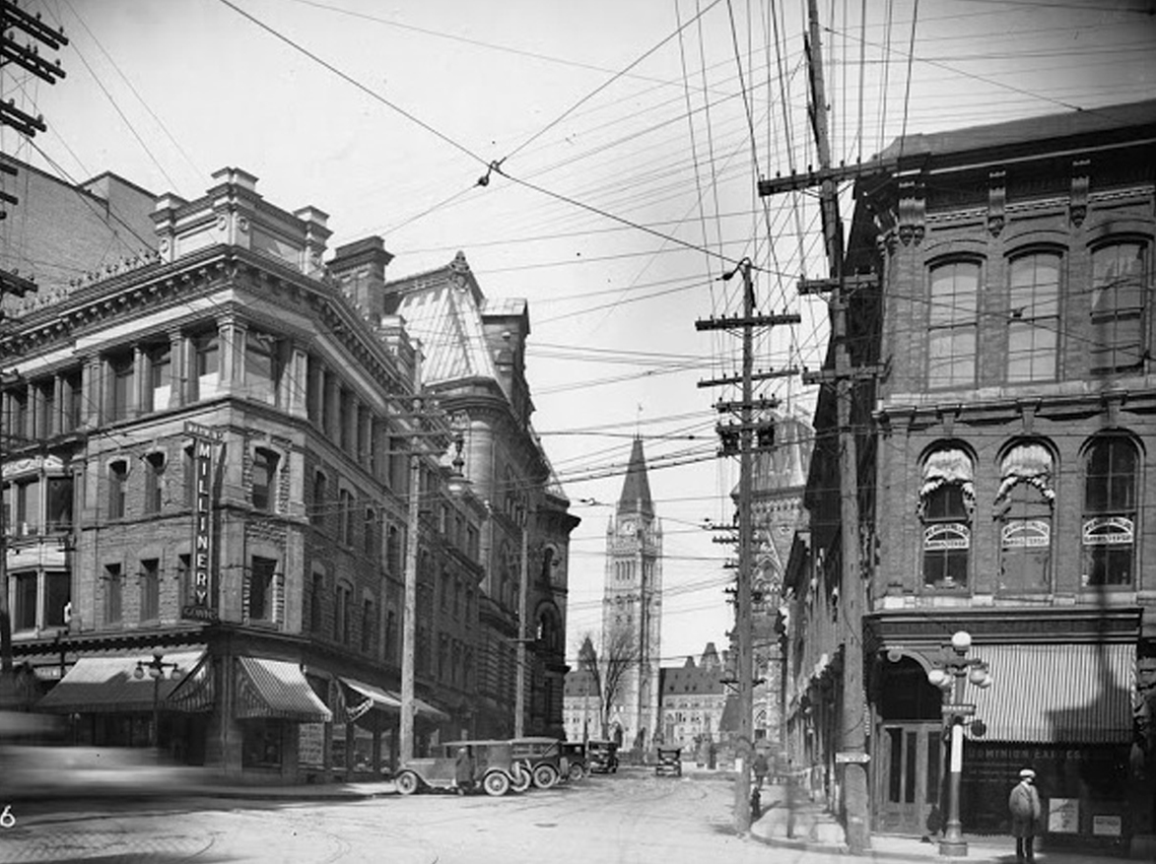
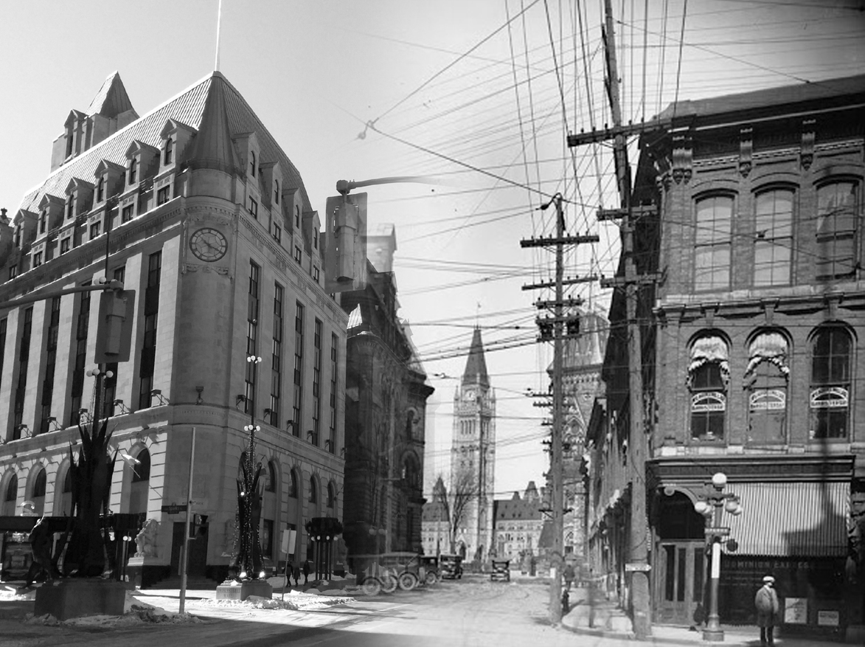
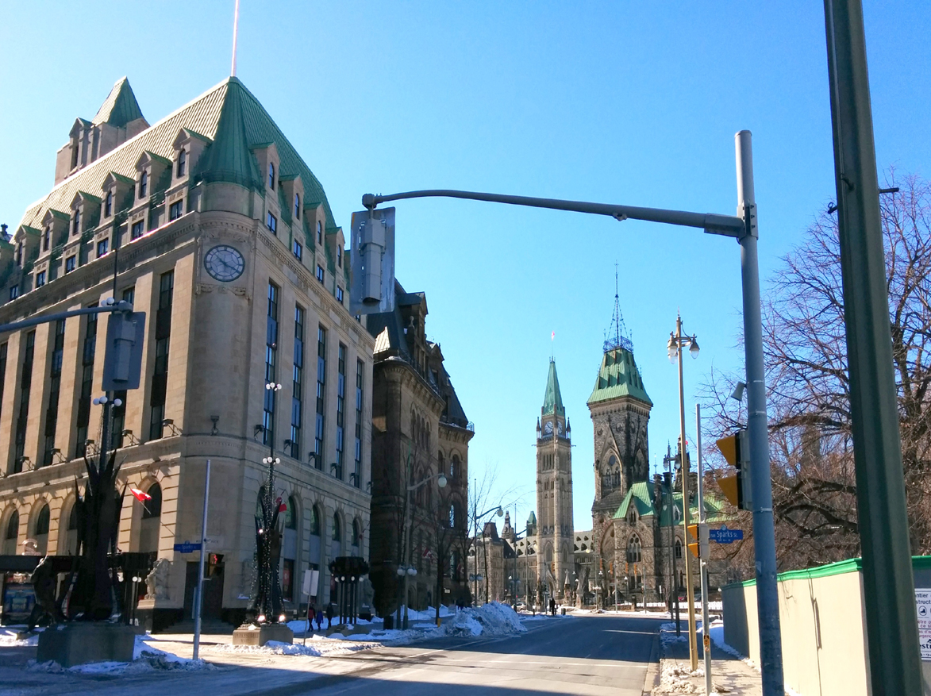
Exploring Ottawa’s Bygone Buildings

Slide 2
Exploring Ottawa’s Bygone Buildings Overview
Who Am I?
Ottawa’s Built History
Bygone Buildings Project
Bygone Buildings Then & Now
Links

Slide 3

Who Am I?
Kevin Ballantyne
Carleton University graduate in Geography
Geomatics developer/analyst for over 10 years
Resident of Ottawa all my life
Life-long interest in the history and development of Ottawa

Slide 4
Ottawa’s Built History

Slide 5


Ottawa’s Built History
Sometimes when people think of history, this happens…
Bear with me…
Notes:
(Before showing photo)
To start off, I’ll talk about the built history of Ottawa. Now I know people’s reaction to hearing about history can be…
(Show photo)
…this. So I will try to keep my discussion on the history brief.

Slide 6
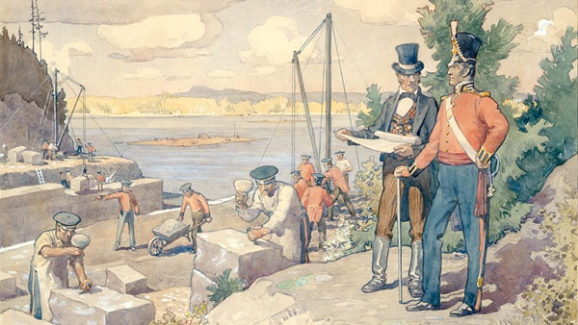
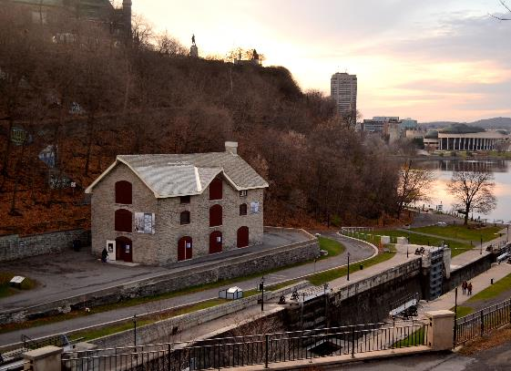
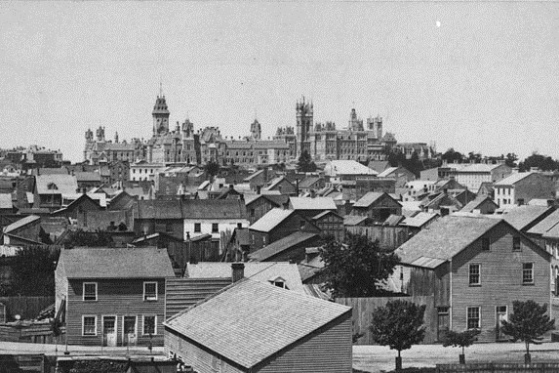
Ottawa’s Built History Start of Ottawa
Started as a settlement for workers of the Rideau Canal
The first permanent buildings in Ottawa were for the military
And for workers in the lumber trade

Slide 7
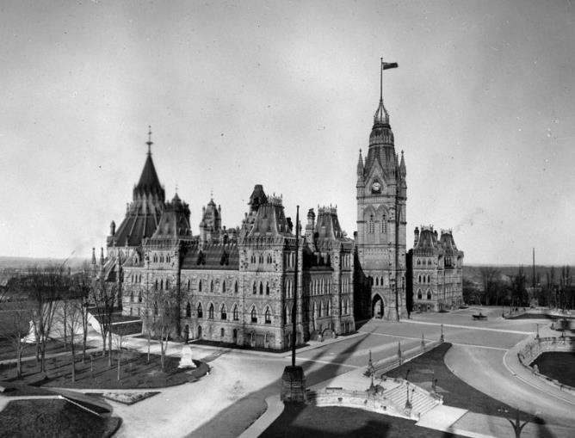
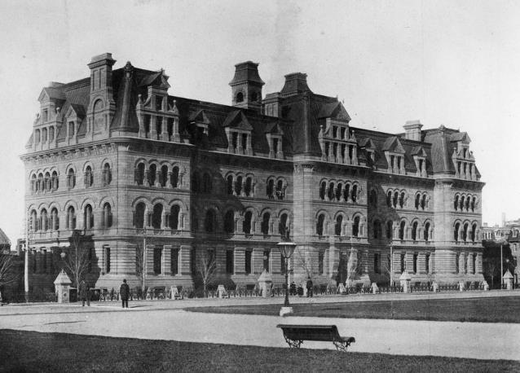
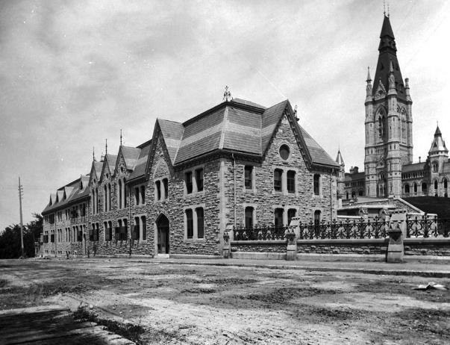
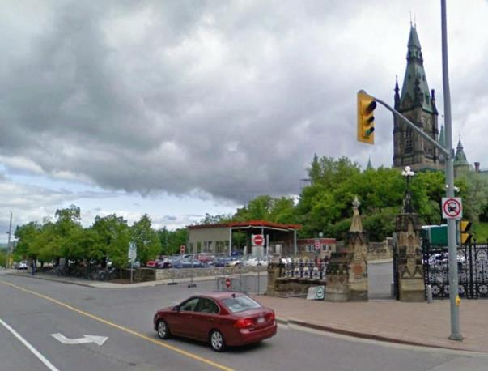
Ottawa’s Built History Government Town
After chosen as Canada’s Capital in 1857, structures needed for government and public service
As country expanded, so did public service with new buildings
The Langevin Building, completed in 1889, still exists today
The Original Supreme Court, built in 1882, demolished 1955

Slide 8
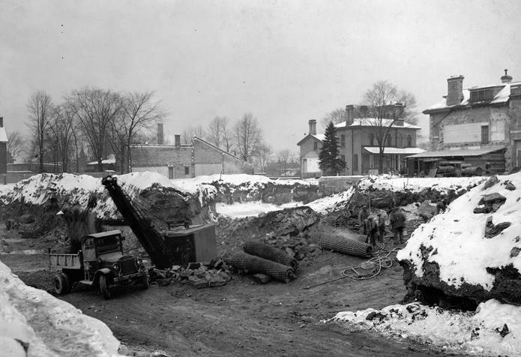
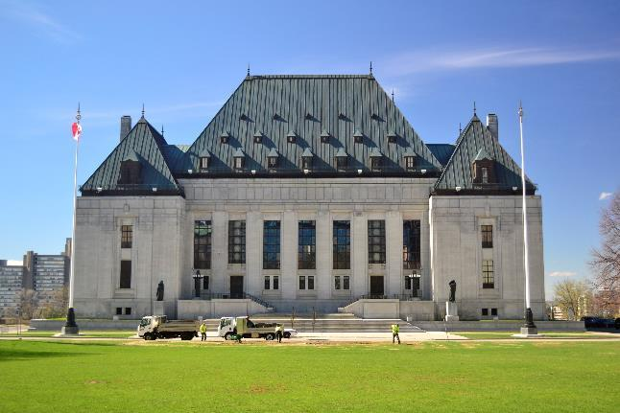
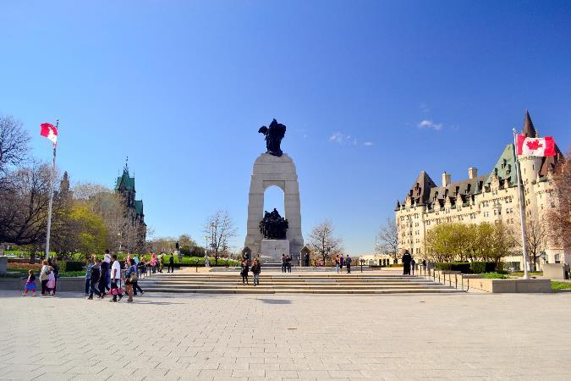
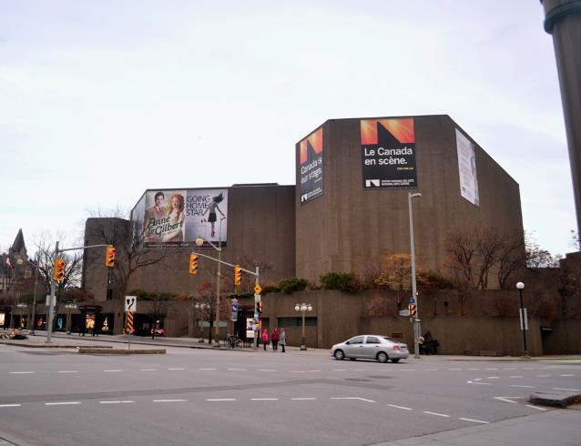
Ottawa’s Built History Large Government Projects
As Canada grew, government initiated projects to beautify the Capital and expand the public service
Some projects include
The Supreme Court, completed 1949
The War Memorial, completed in 1939
The National Arts Centre, completed in 1969

Slide 9
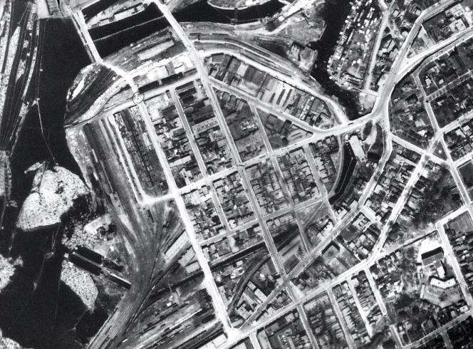
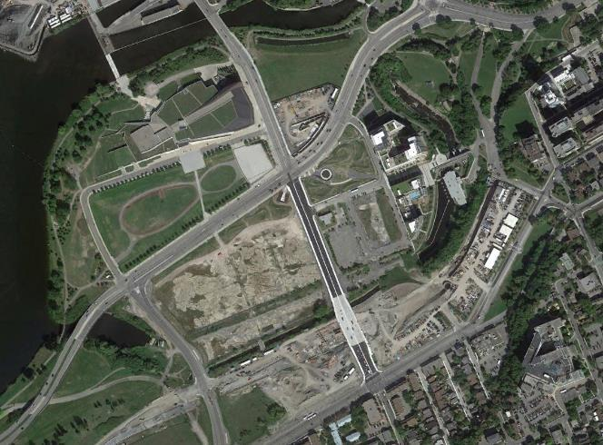
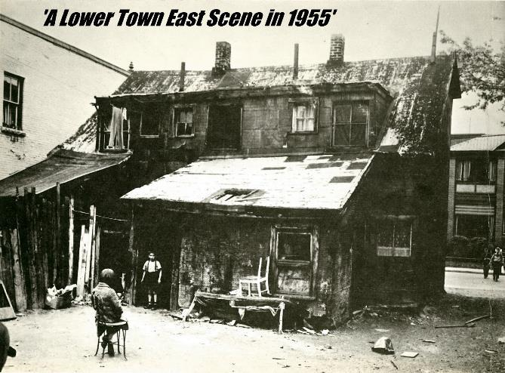
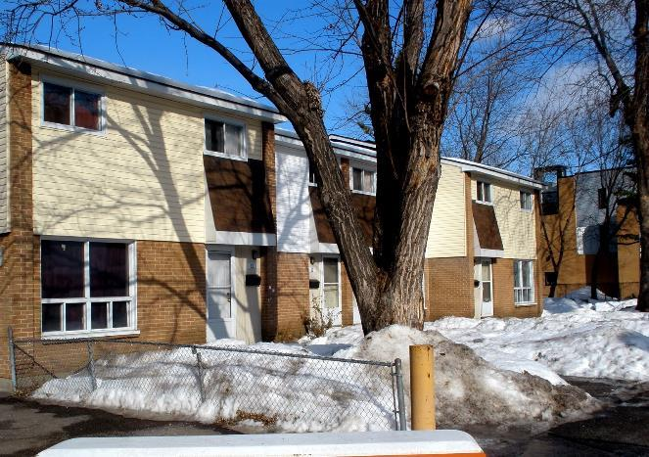
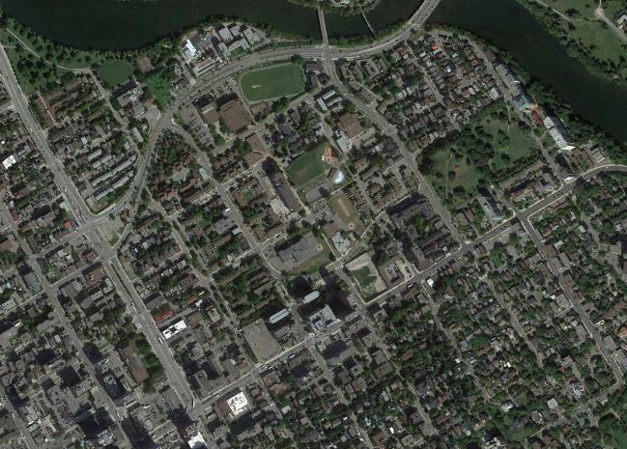
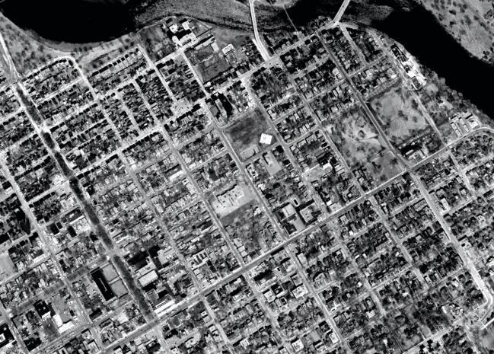
Ottawa’s Built History Urban Renewal
Municipal and federal governments took on renewal projects
Lebreton Flats
Community west of downtown
About 154 acres expropriated by federal government between 1962-1965
Left vacant for 4 decades until construction of War Museum
Lowertown East
Community east of Byward Market
About 100 acres expropriated by City of Ottawa in late-1960s
Aging houses quickly replaced with modern townhouses and apartments
War Museum
Lebreton Flats
Lowertown East

Slide 10
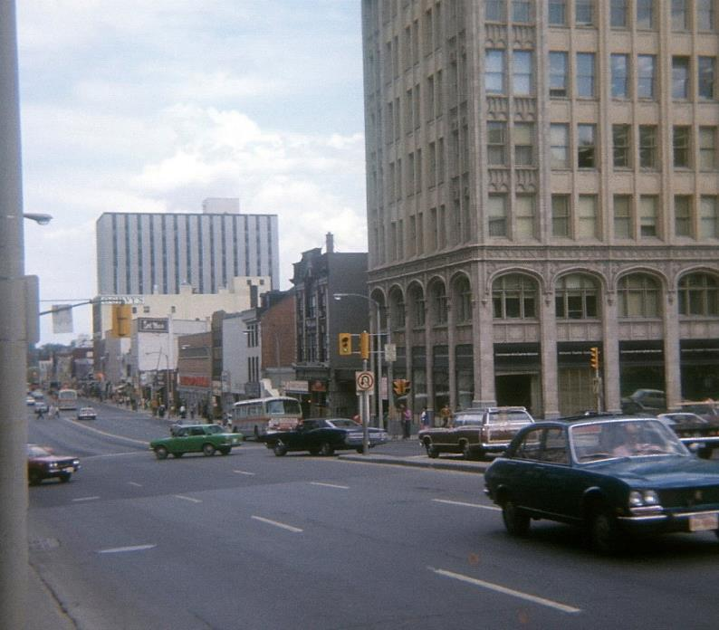
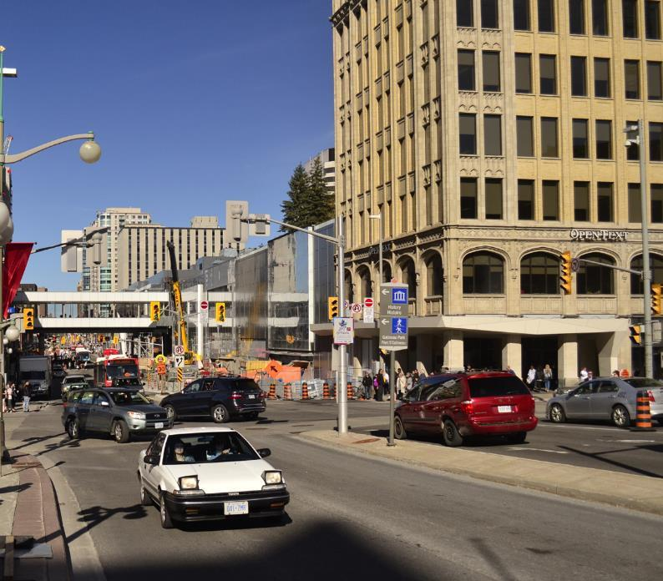
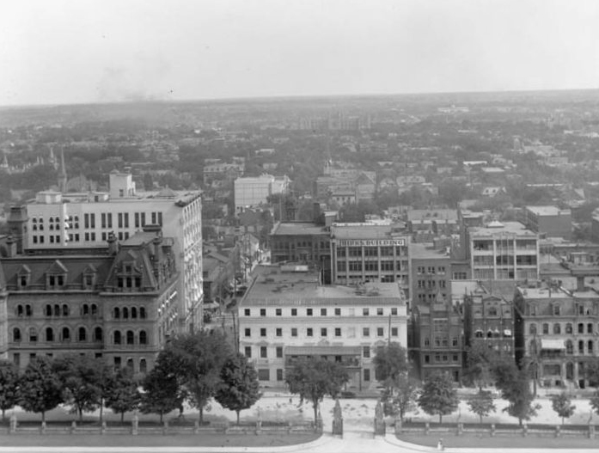
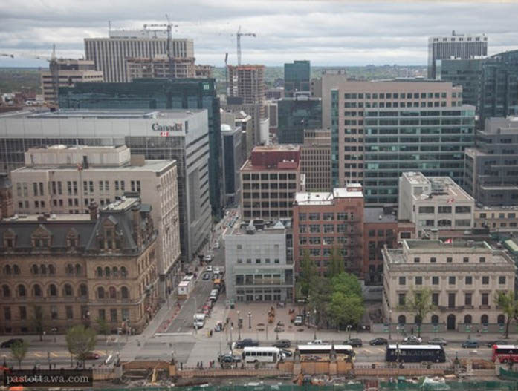
Ottawa’s Built History Private Ventures
Private businesses also helped shape the Capital, such as:
The Rideau Centre opened in 1983
Other private ventures in Centretown
Manulife Place
World Exchange Plaza
Royal Bank Building
(now Thomas D’Arcy McGee)

Slide 11
Bygone Buildings Project

Slide 12
Bygone Buildings Project Overview
Motivation for project
Software Choices
Fire Insurance Plans
Georeferencing Plans
Conversion to KMZ
Outlining the buildings
Website design

Slide 13
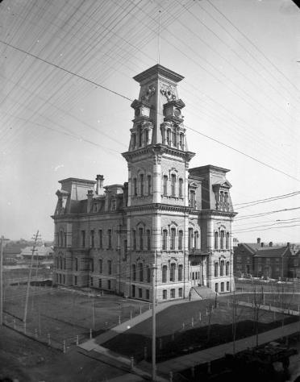
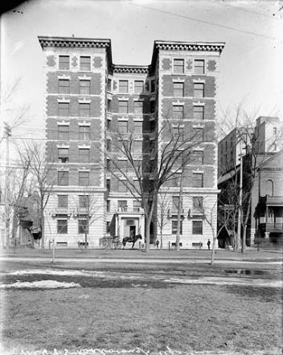
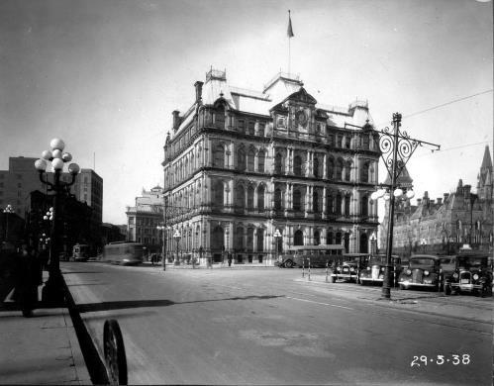
Bygone Buildings Motivation for Project
Ottawa Post Office
Ottawa City Hall
Roxborough Apartments
Found historic photos on Library & Archives Canada
Geographic location hard to determine
No single source of the history of buildings
Idea to create an interactive map

Slide 14




Bygone Buildings Software Choices
Mainly open-source and free software

Slide 15
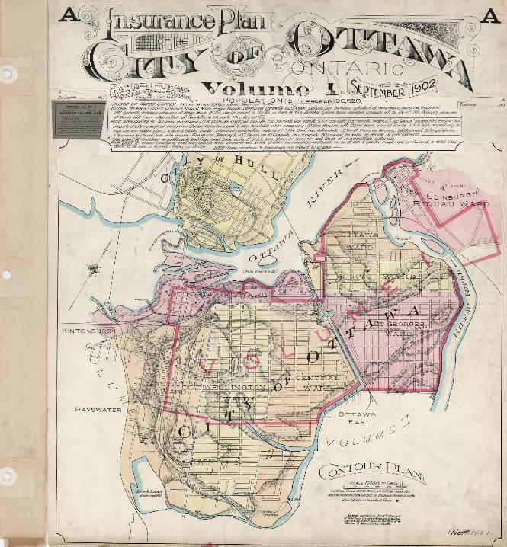
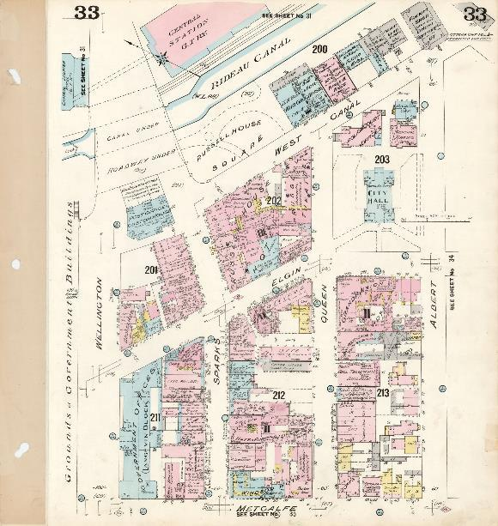
Bygone Buildings Fire Insurance Plans
Insurance plans of the city of Ottawa, Ontario, Volume 1, September 1902, revised 1912
Available at Library & Archives Canada, MIKAN no. 3816030

Slide 16
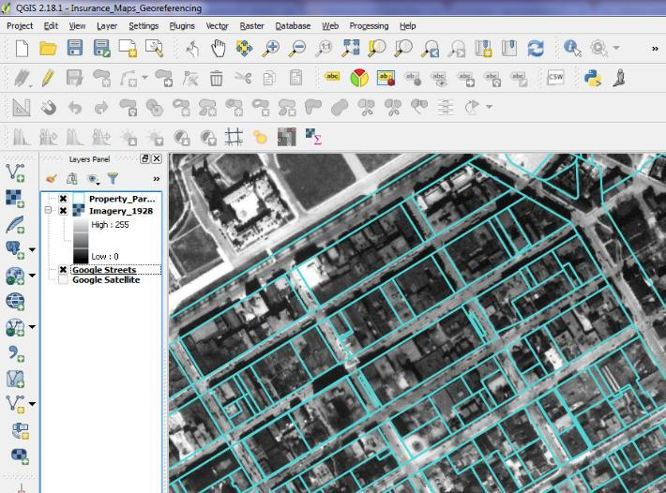
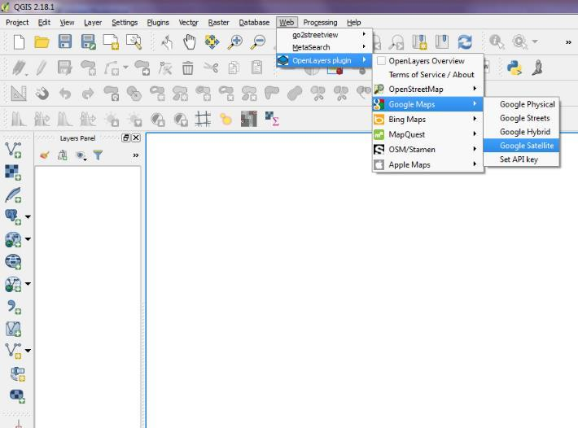
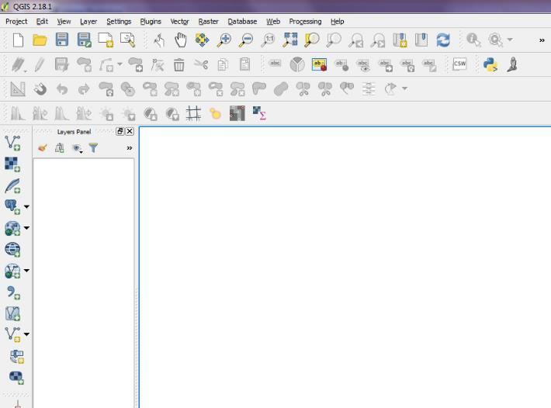
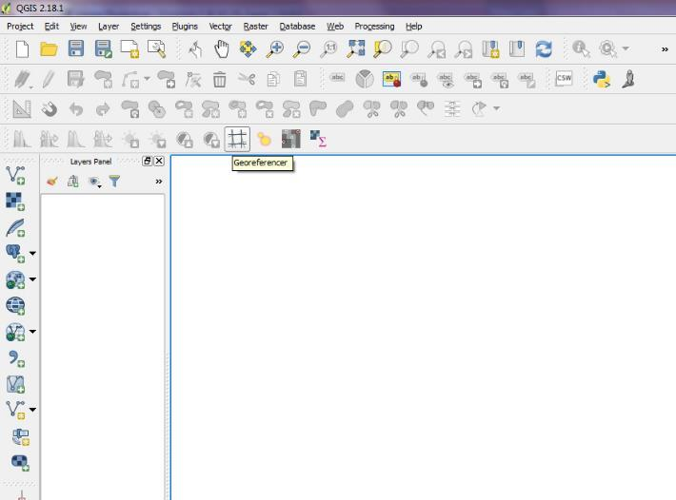
Bygone Buildings Georeferencing Plans
Using tools in Quantum GIS (QGIS)
Georeferencer
Google Satellite Plugin
Other datasets
From GeoOttawa ArcGIS Services
Property Parcels
Historical aerial photos from 1928, 1958 and 1965

Slide 17
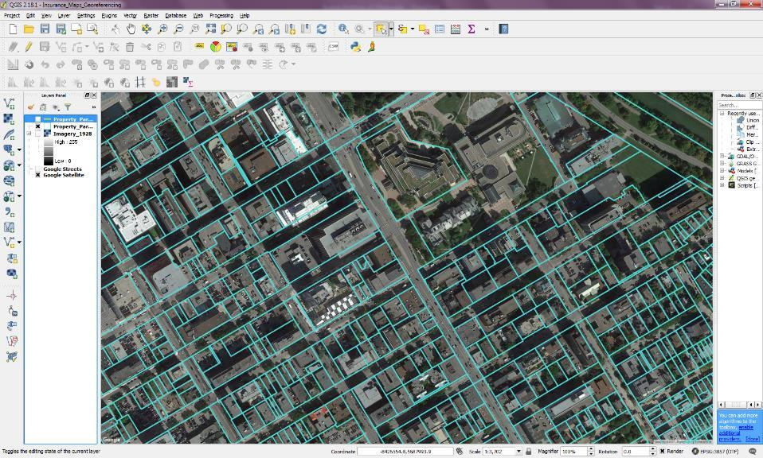
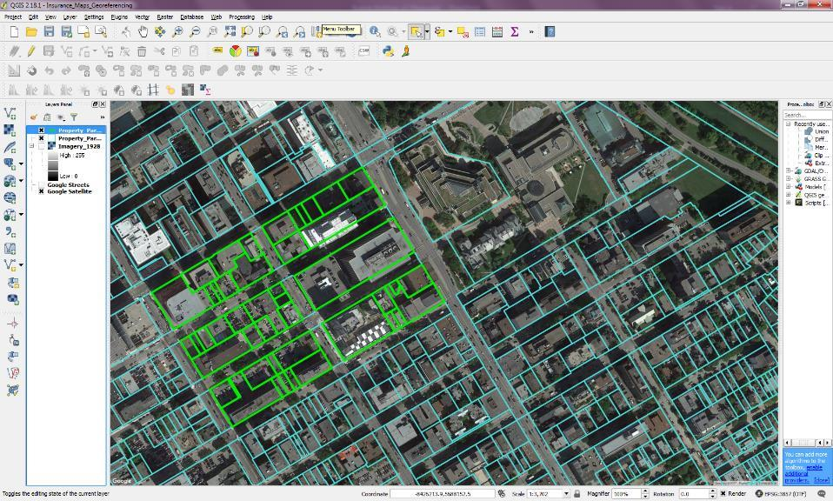
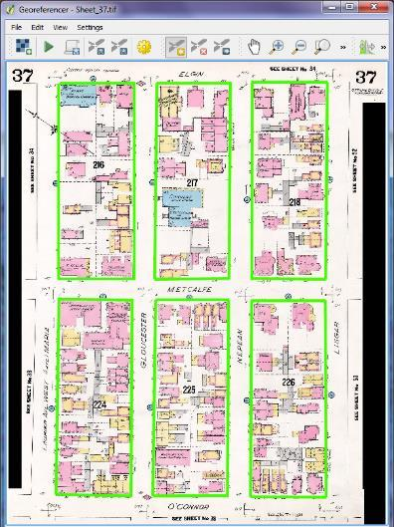
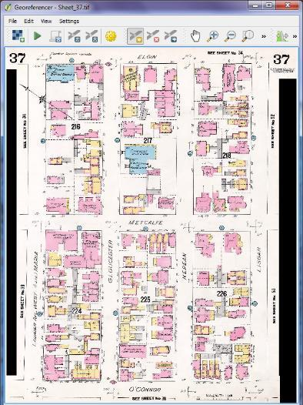
Bygone Buildings Georeferencing Plans
Use the property parcels to georeference the plans
Place a point at each street corner, one per corner
Each row of points should line up for best results
Run georeferencer and save as a GeoTIFF

Slide 18

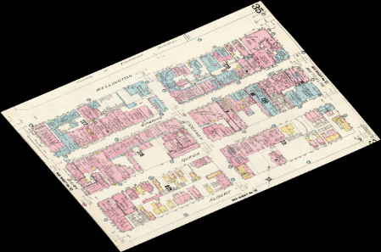
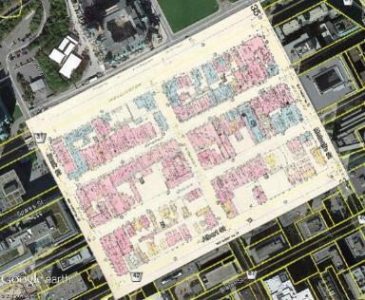

Bygone Buildings Conversion to KMZ
Python Script with
GDAL Translate
Insurance Plan GeoTIFF
Insurance Plan KMZ
Raw GeoTIFF not in convenient format for general user
Create Python script implementing GDAL Translate and using PNG format to allow transparency (to remove the black)
Convert to KMZ so user can load into Google Earth as an overlay

Slide 19
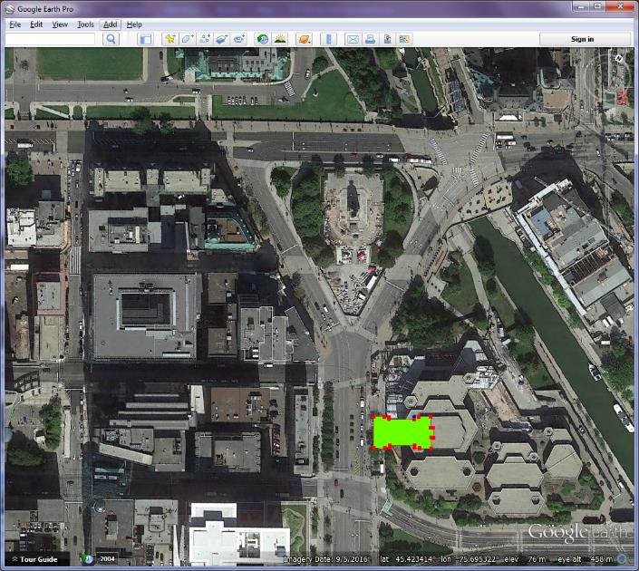
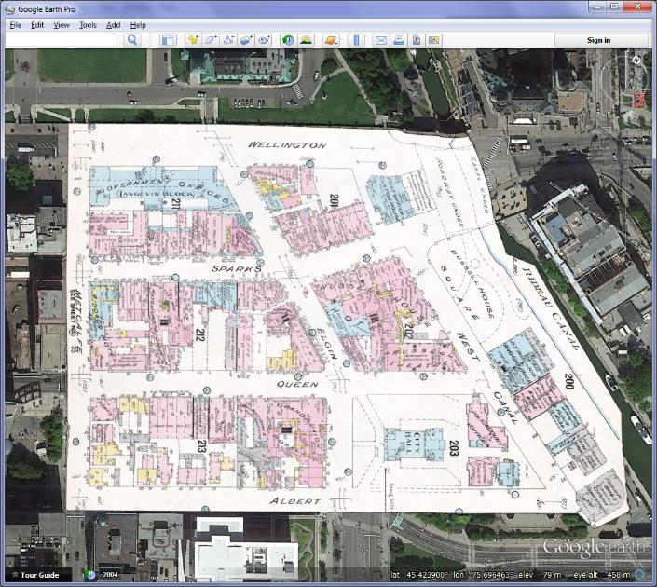
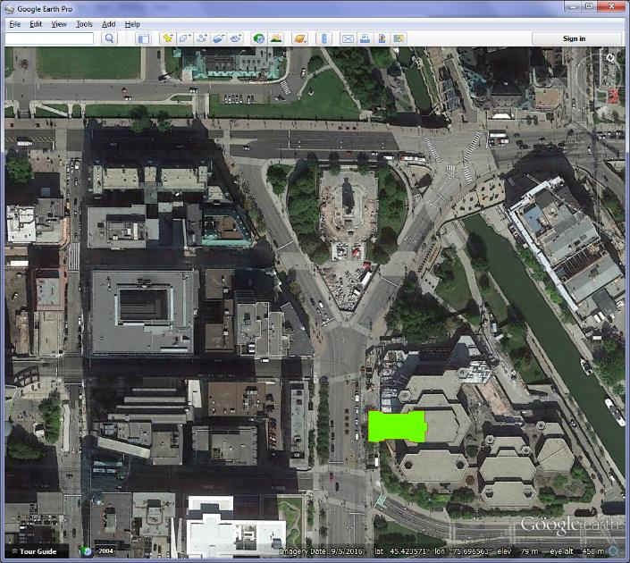
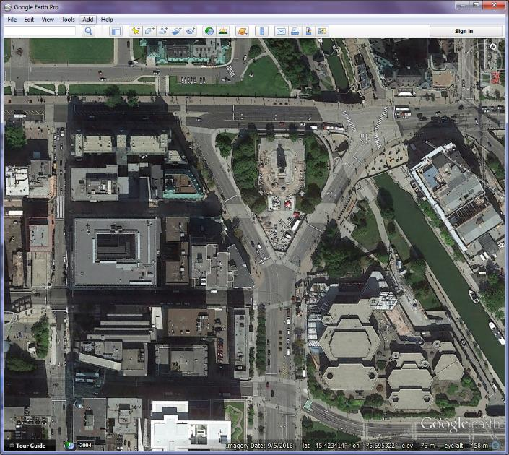
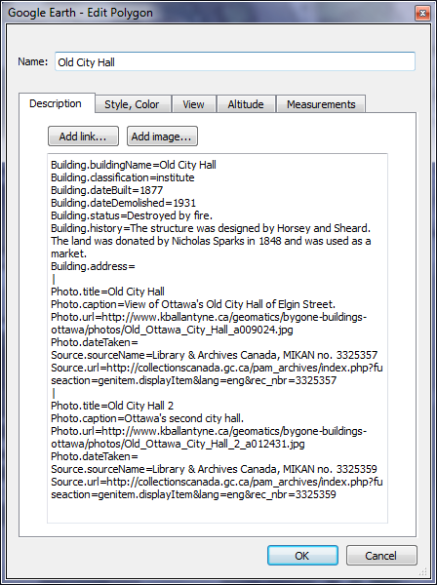
Bygone Buildings Collecting Buildings
Load Fire Insurance Plan KMZ into Google Earth
Outline any buildings containing photos found in research
Add information for input into the database
Include table names, columns and values, separated with equal signs
Separate each photo with a vertical line
Save new building as a KML File
Column
Value
Table
Photo 1
Photo 2

Slide 20
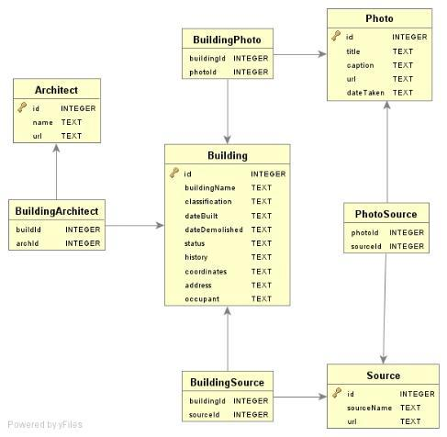

Bygone Buildings Database
SQLite Database
Python script to import
KML to Database
Import KML with buildings from previous step into database using Python and SQLite
Database contains tables for building information, photos, sources and architects

Slide 21
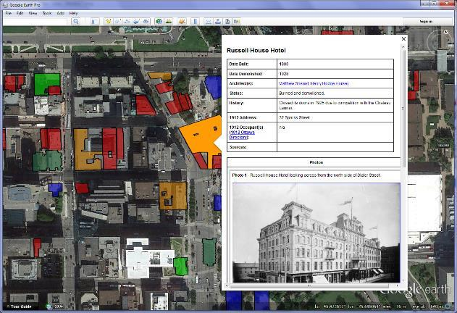
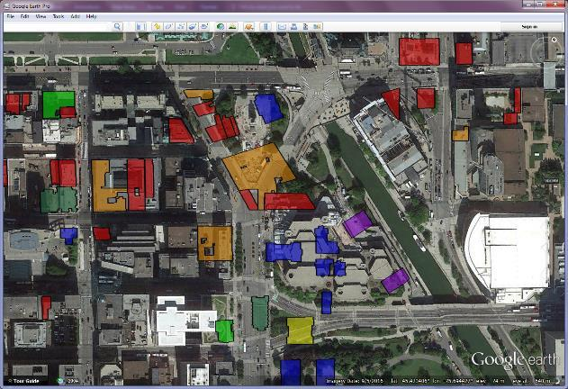
Bygone Buildings Final KML
Bygone Buildings KML
SQLite Database
Python script to convert
database to KML
Use Python script to convert database to the final KML with the Bygone Buildings

Slide 22
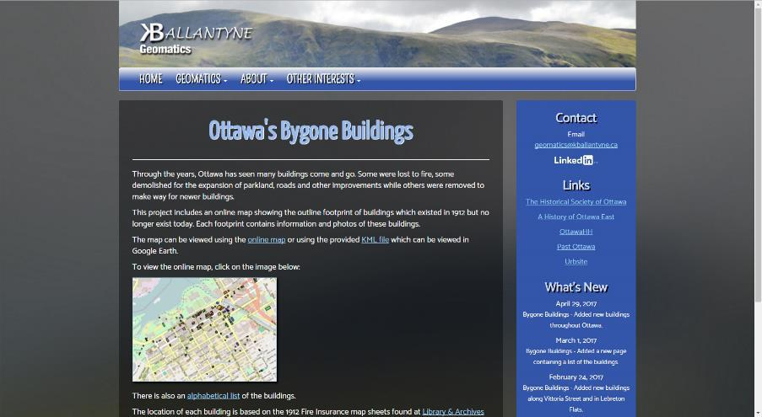
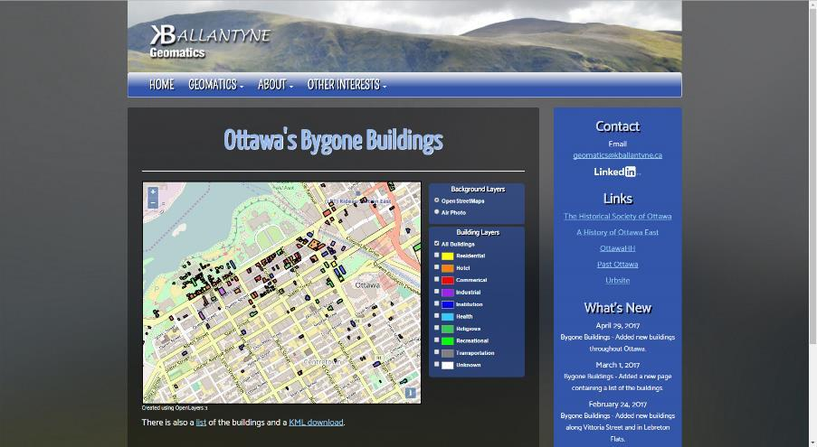
Bygone Buildings Web Release
Project Homepage
Project Map
Created personal website to host the Bygone Buildings project
Project page:
http://www.kballantyne.ca/geomatics/bygone-buildings-ottawa/

Slide 23
Bygone Buildings Then & Now

Slide 24
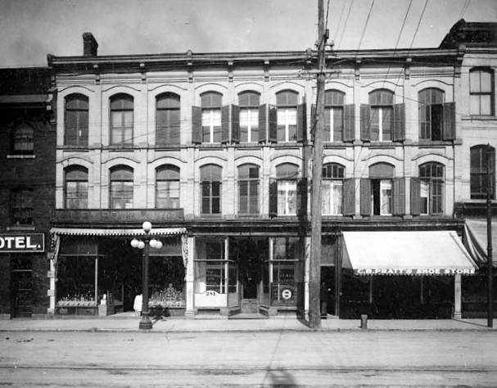

Supreme Court of Canada Confederation Building & Library & Archives Canada
Wellington Apartments

Slide 25








War Memorial Confederation Square & National Arts Centre
Bodega Hotel
Russell House Hotel
Old Post Office

Slide 26






Elgin Street & Confederation Park
Knox Church
Roxborough Apartments

Slide 27








Byward Market Area
2nd Byward Market Building
Daly Building
Government Printing Bureau

Slide 28
Exploring Ottawa’s Bygone Buildings Links
My Website
Geomatics Page: www.kballantyne.ca/geomatics
Project Page: www.kballantyne.ca/geomatics/bygone-buildings-ottawa
Project Map: www.kballantyne.ca/geomatics/bygone-buildings-ottawa/map
Fire Insurance Plans
Raw Images: collectionscanada.gc.ca/pam_archives/index.php?fuseaction=genitem.displayItem&lang=eng&rec_nbr=3816030
Georeferenced at Carleton Library Website: carleton-u.maps.arcgis.com/apps/PublicInformation/index.html?appid=c40ef2ffe4a24fedbcbdb1474ba4c428

Slide 29
Questions?
www.kballantyne.ca
geomatics@kballantyne.ca

